Slide 1


INTERNSHIP CAPSTONE FINAL PROJECT
Tennis Game Analytics Dashboard
UNLOCKING GLOBAL TOURNAMENT INSIGHTS WITH SPORTRADAR API & STREAMLIT

Slide 2


INTRODUCTION
In the fast-evolving world of professional sports, data has become the ultimate competitive advantage.
Domain Focus
Sports Analytics specifically targeting competition structures, player participation, and real-time performance tracking.
This project focuses on the Tennis ecosystem, bridging the gap between raw Sportradar API feeds and meaningful business intelligence. We developed a comprehensive solution for managing, visualizing, and analyzing competition data.

Slide 3





OBJECTIVES
Data Extraction
Normalization
Interactive UI
Establishing automated connections to Sportradar's Tennis V3 API to pull live ranking and event data.
Designing a robust 3NF SQL schema to store nested information about venues, competitors, and hierarchies.
Developing a Streamlit-based dashboard for instant filtering, search, and trend visualization.

Slide 4
METHODOLOGY
Extraction: Python scripts utilizing requests to fetch tournament feeds (JSON).
Transformation: Flattening complex nested structures using Pandas for relational compatibility.
Load (MySQL): Schema-driven batch insertion with referential integrity.
Analysis: Executing optimized SQL queries to derive insights like parent-child competition hierarchies.
Dashboard: Integrating the SQL database with a Streamlit front-end for user interaction.

Slide 5


WORKFLOW & ARCHITECTURE
Sportradar API
Python Processing
MySQL Server
Streamlit Dashboard
Source Data (JSON)
ETL & Transformation
Relational Storage
Visualization UI

Slide 6


KEY FINDINGS
Geographic Dominance
Top Tier Stability
The USA and Europe hold over 60% of the top slots, indicating robust developmental structures in those specific regions.
Positions 1-3 show exceptionally high stability, with points gaps between players becoming narrowest in the Top 10 range.
Performance Concentration
Top Tier Stability
The "Top 10" players dominate nearly 45% of the total points pool, highlighting a massive performance gap.
Men’s Singles account for 40% more data entries than Doubles, reflecting higher global market density.

Slide 7
PHASE II
Visuals & Dashboards
Interactive Rankings Explorer UI

Slide 8




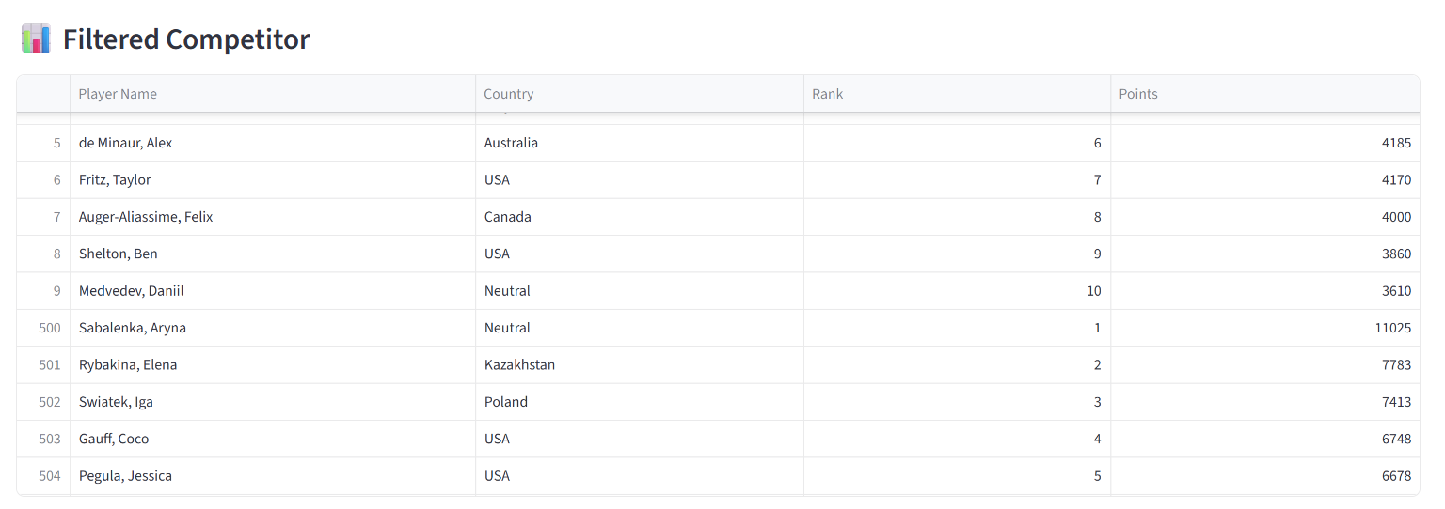
DASHBOARD METRIC SNAPSHOT

Slide 9
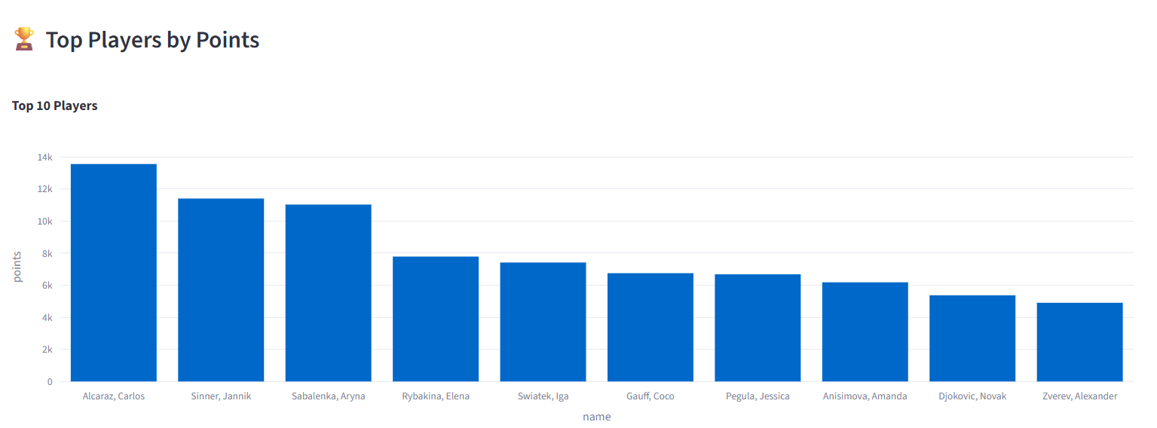
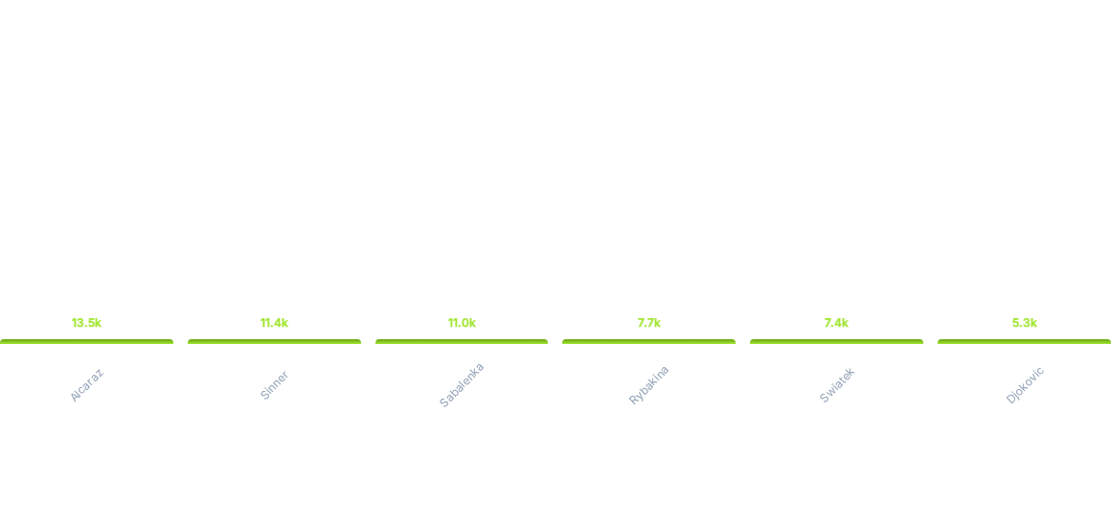
POINTS DISTRIBUTION ANALYSIS

Slide 10
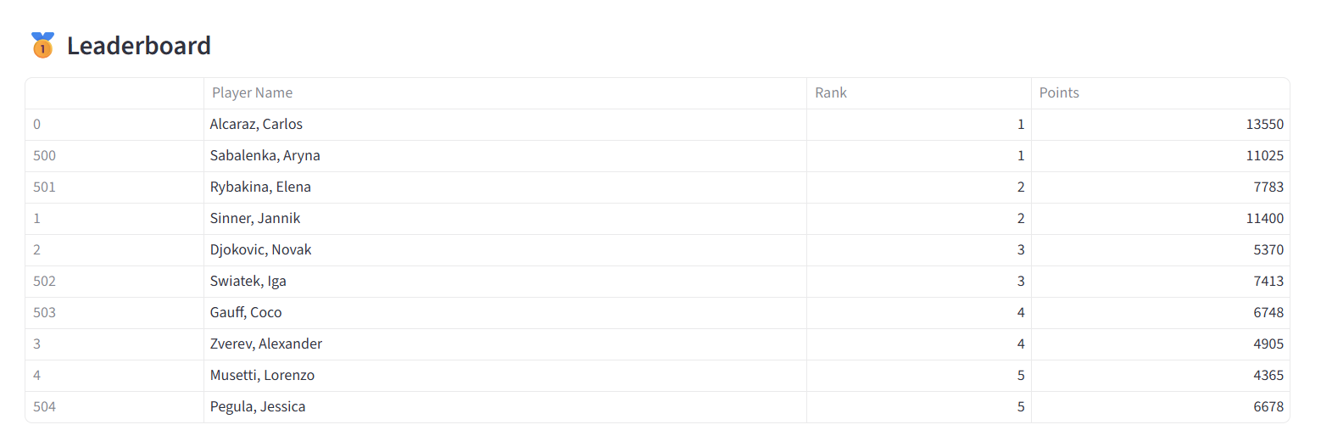
POINTS DISTRIBUTION ANALYSIS

Slide 11
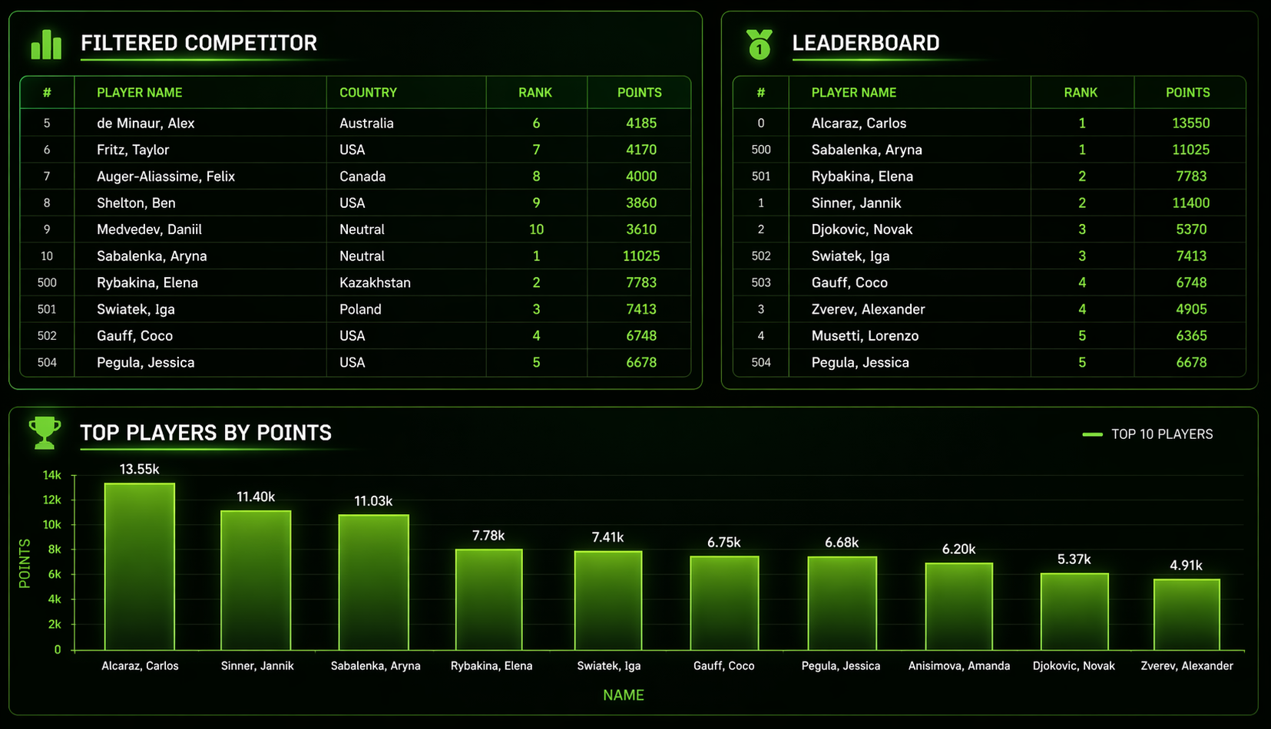
Final Dashboard

Slide 12

CONCLUSION
The project successfully transitioned from raw API data to an interactive business tool. By automating the ETL pipeline and providing a user-centric dashboard, we have created a scalable asset for sports analysts to explore tournament hierarchies and athlete performance.
Key Outcomes: 100% data extraction accuracy and optimized SQL query performance for real-time visualization.

Slide 13


PROJECT TEAM & CONTRIBUTIONS
Rupali Jain
Batch 15th Oct
Shreya Thaware
Batch 1st Oct
•
Establish API Connection & Key Management.
•
Data Cleaning & Transformation in Python & SQL.
•
Fetched Competitions, Complexes & Rankings.
•
Converted JSON to Pandas Structured Format.
•
Managed the Raw JSON Data Collection phase.
•
SQL Schema creation & clean data ingestion.
Muskan Bhardwaj
Batch 15th Oct
Guransh Dhiman
Batch 15th Oct
•
Advanced SQL Querying & Trend Discovery.
•
Streamlit Dashboard Development & UI Build.
•
Analysis of Categories & Venue distribution.
•
Dynamic Filter & Search functionality logic.
•
Preparation of Insights for dashboard metrics.
•
Final Web Application deployment & testing.

Slide 14


ACKNOWLEDGMENTS
Support & Mentorship
We extend our deepest gratitude to our mentors and supervisors for their technical guidance throughout this journey.
Labmentix
Collaborative Effort
This project was a collective effort of the DA/BA batches, demonstrating teamwork and dedication to analytical excellence.
Opportunity & Support
For providing the platform and resources to make this internship project a success.

Slide 15
Any Questions?
Thank you for your time and patience.

